Slide 1
Human Computer Interaction (HCI)
Computer Science Department

Slide 2


Slide 3
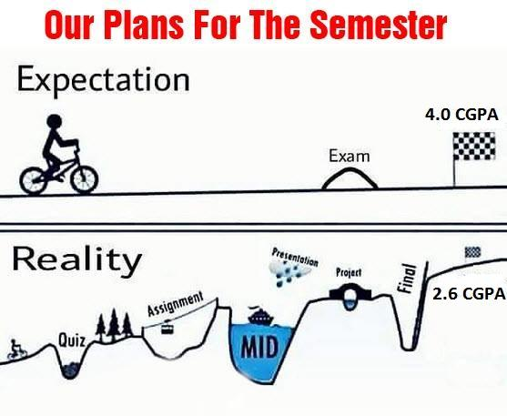

Slide 4

Human

Slide 5
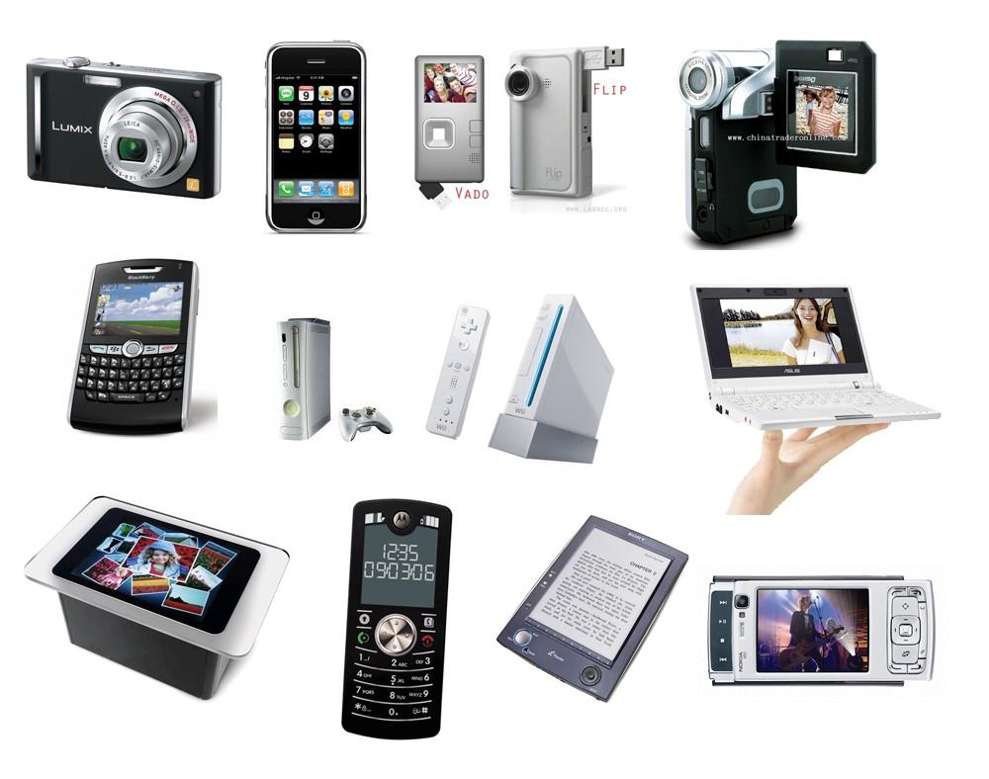
Computer
All electronic devices around us are computers

Slide 6
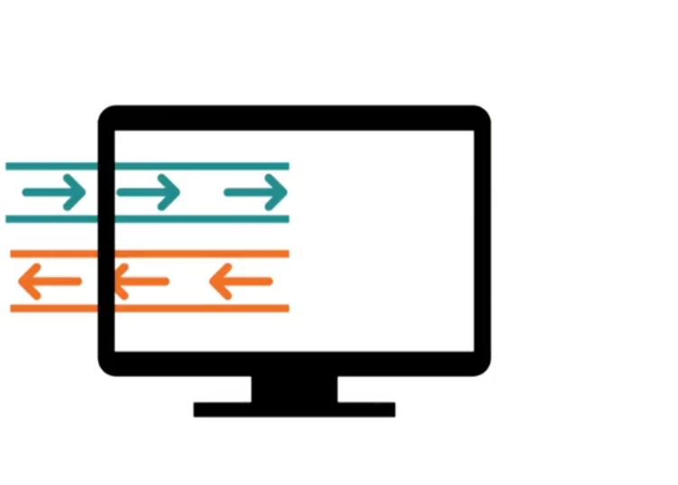

User Interaction
Human
Computer

Slide 7
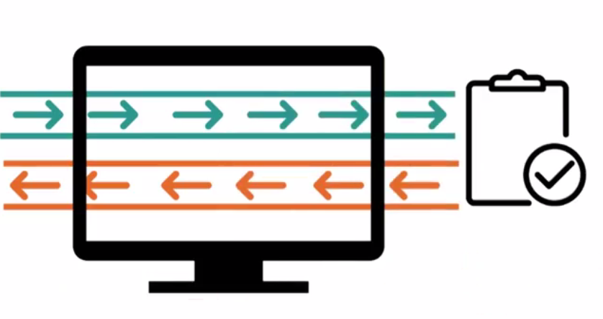
User Interaction
Human
Computer
Task

Slide 8

User Interaction
Human
Task

Slide 9
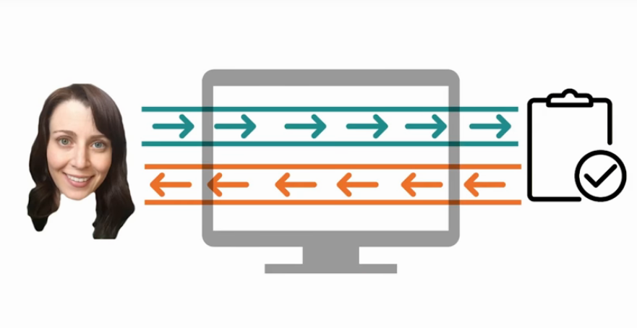
User Interaction
Human
Computer
Task

Slide 10
Class Activity
Think of an example where you spent most of your time thinking about
The task
The tool

Slide 11
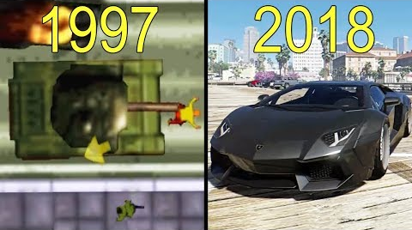
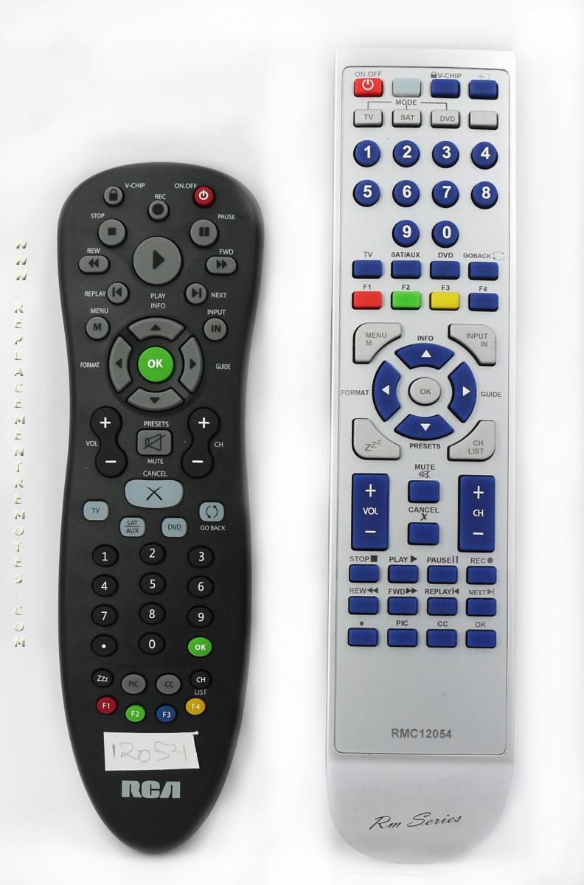
Solution Example
Task
Video Games
Tool
TV remote
GTA

Slide 12
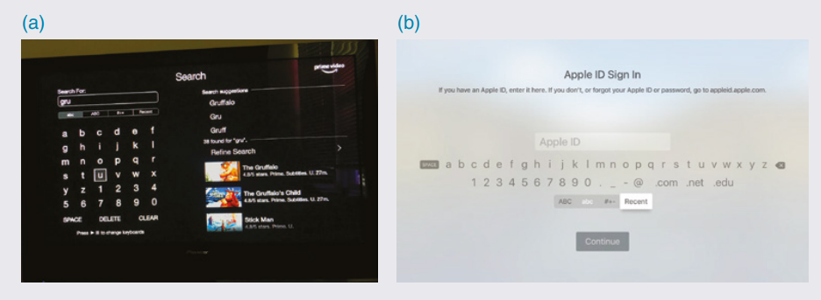
Smart Screens

Slide 13
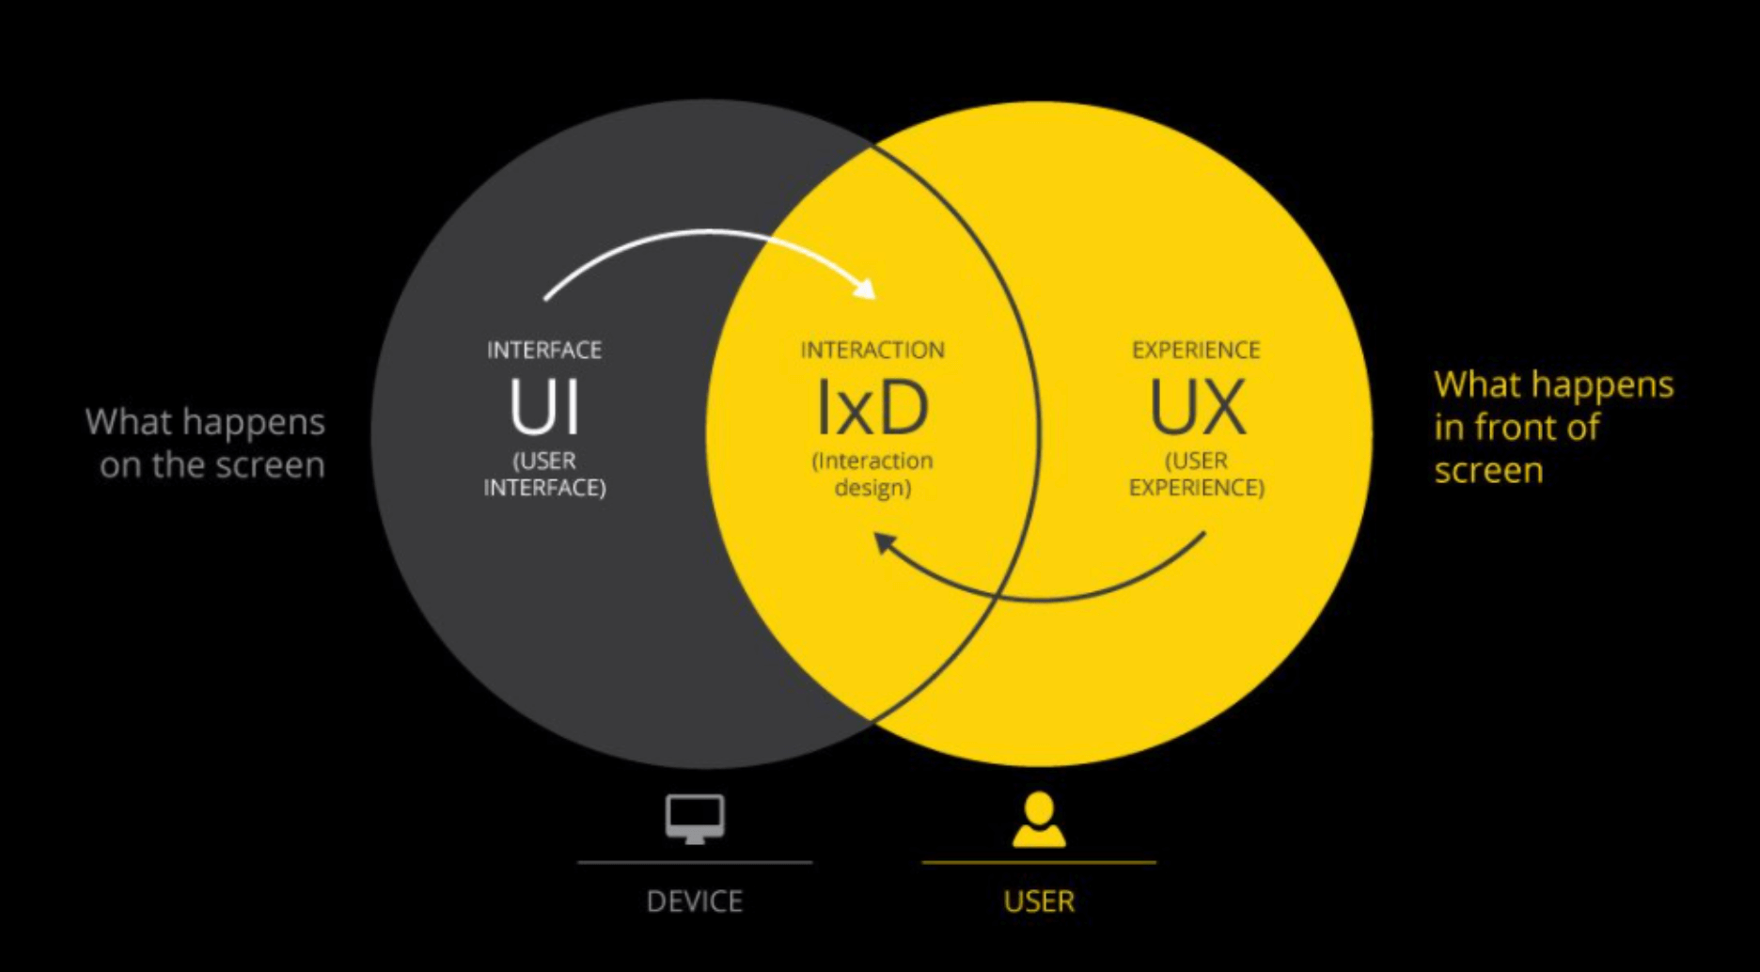
Interaction Design
Designing interactive products to support the way people communicate and interact in their everyday and working life.

Slide 14
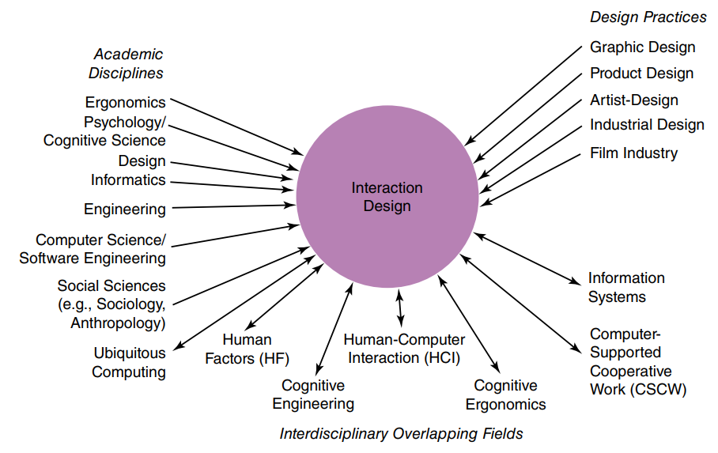
Interaction Design

Slide 15
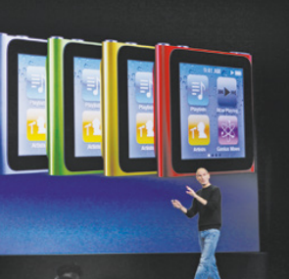
User Experience
The user experience refers to how a product behaves and is used by people in the real world.
It encompasses,
“all the all aspects of the end user’s interaction with the company, its services, and its products.”
(Jakob Nielsen and Don Norman, 2014)
Don’t design user experience, but design FOR user experience.

Slide 16
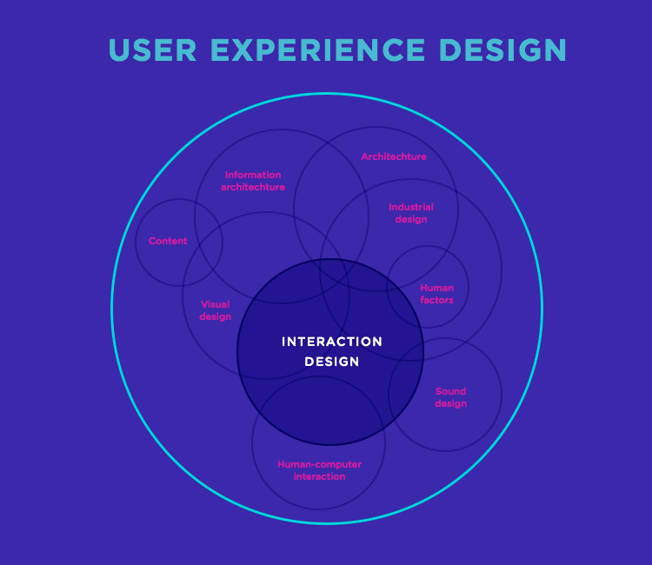
Interaction Design VS User Experience Design
User experience encapsulates how a user interacts with and experiences a product, system or service.
Interaction design supports how user interacts with the products via an interface.

Slide 17
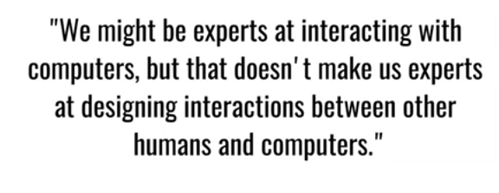
Why HCI?
Human Computer Interaction is the study of how people interact with computers and to what extent computers are or are not developed for successful interaction with human beings.

Slide 18
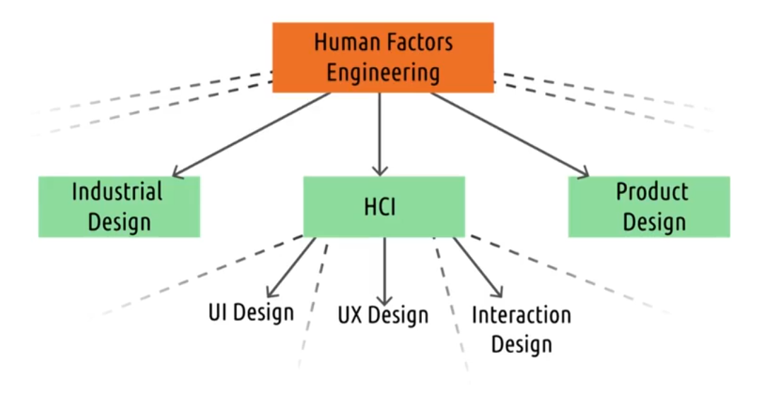
Human Computer Interaction(HCI)

Slide 19
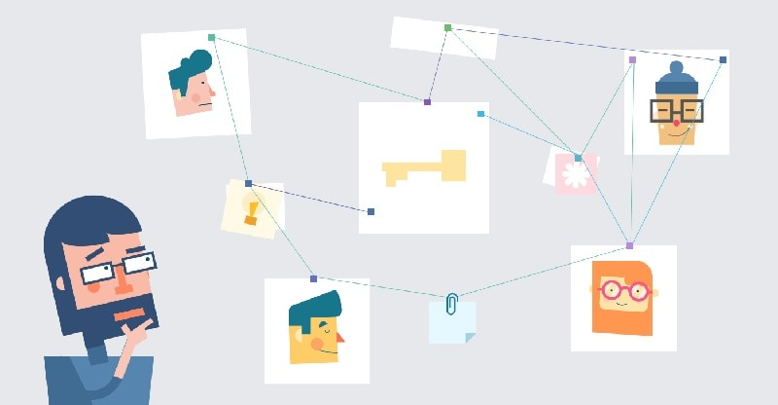
Understanding Users
Understand user in the context they live, work and learn to match user’s need.

Slide 20
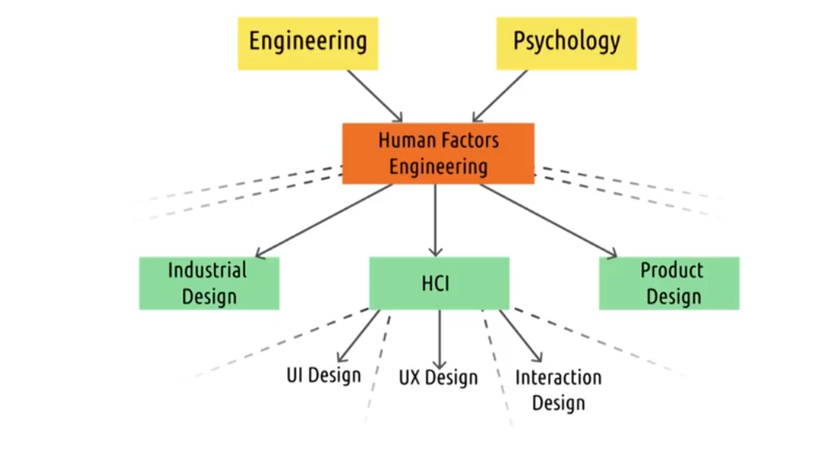
HCI and Psychology

Slide 21
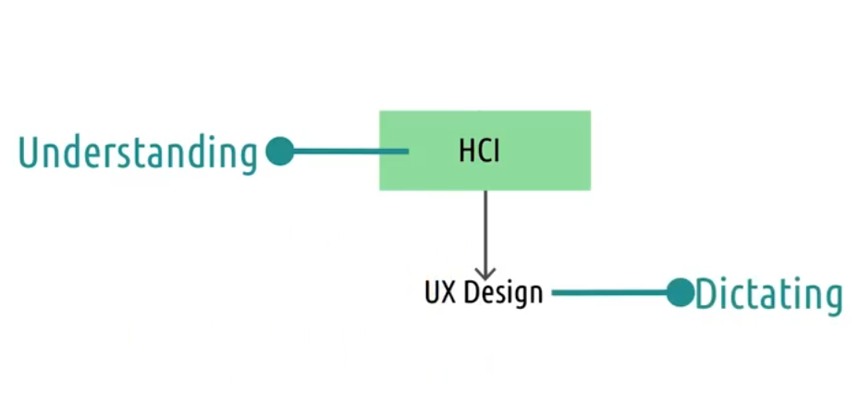
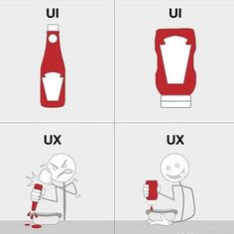
HCI and UX Design

Slide 22
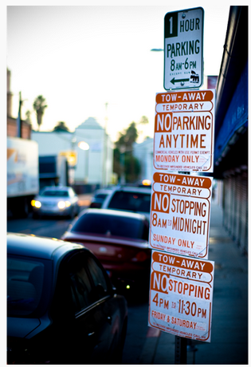
Parking Sign Example
Try to read the sign!

Slide 23
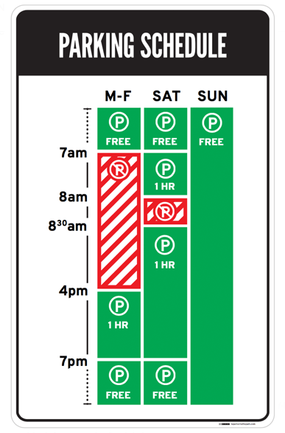
Parking Sign Example

Slide 24
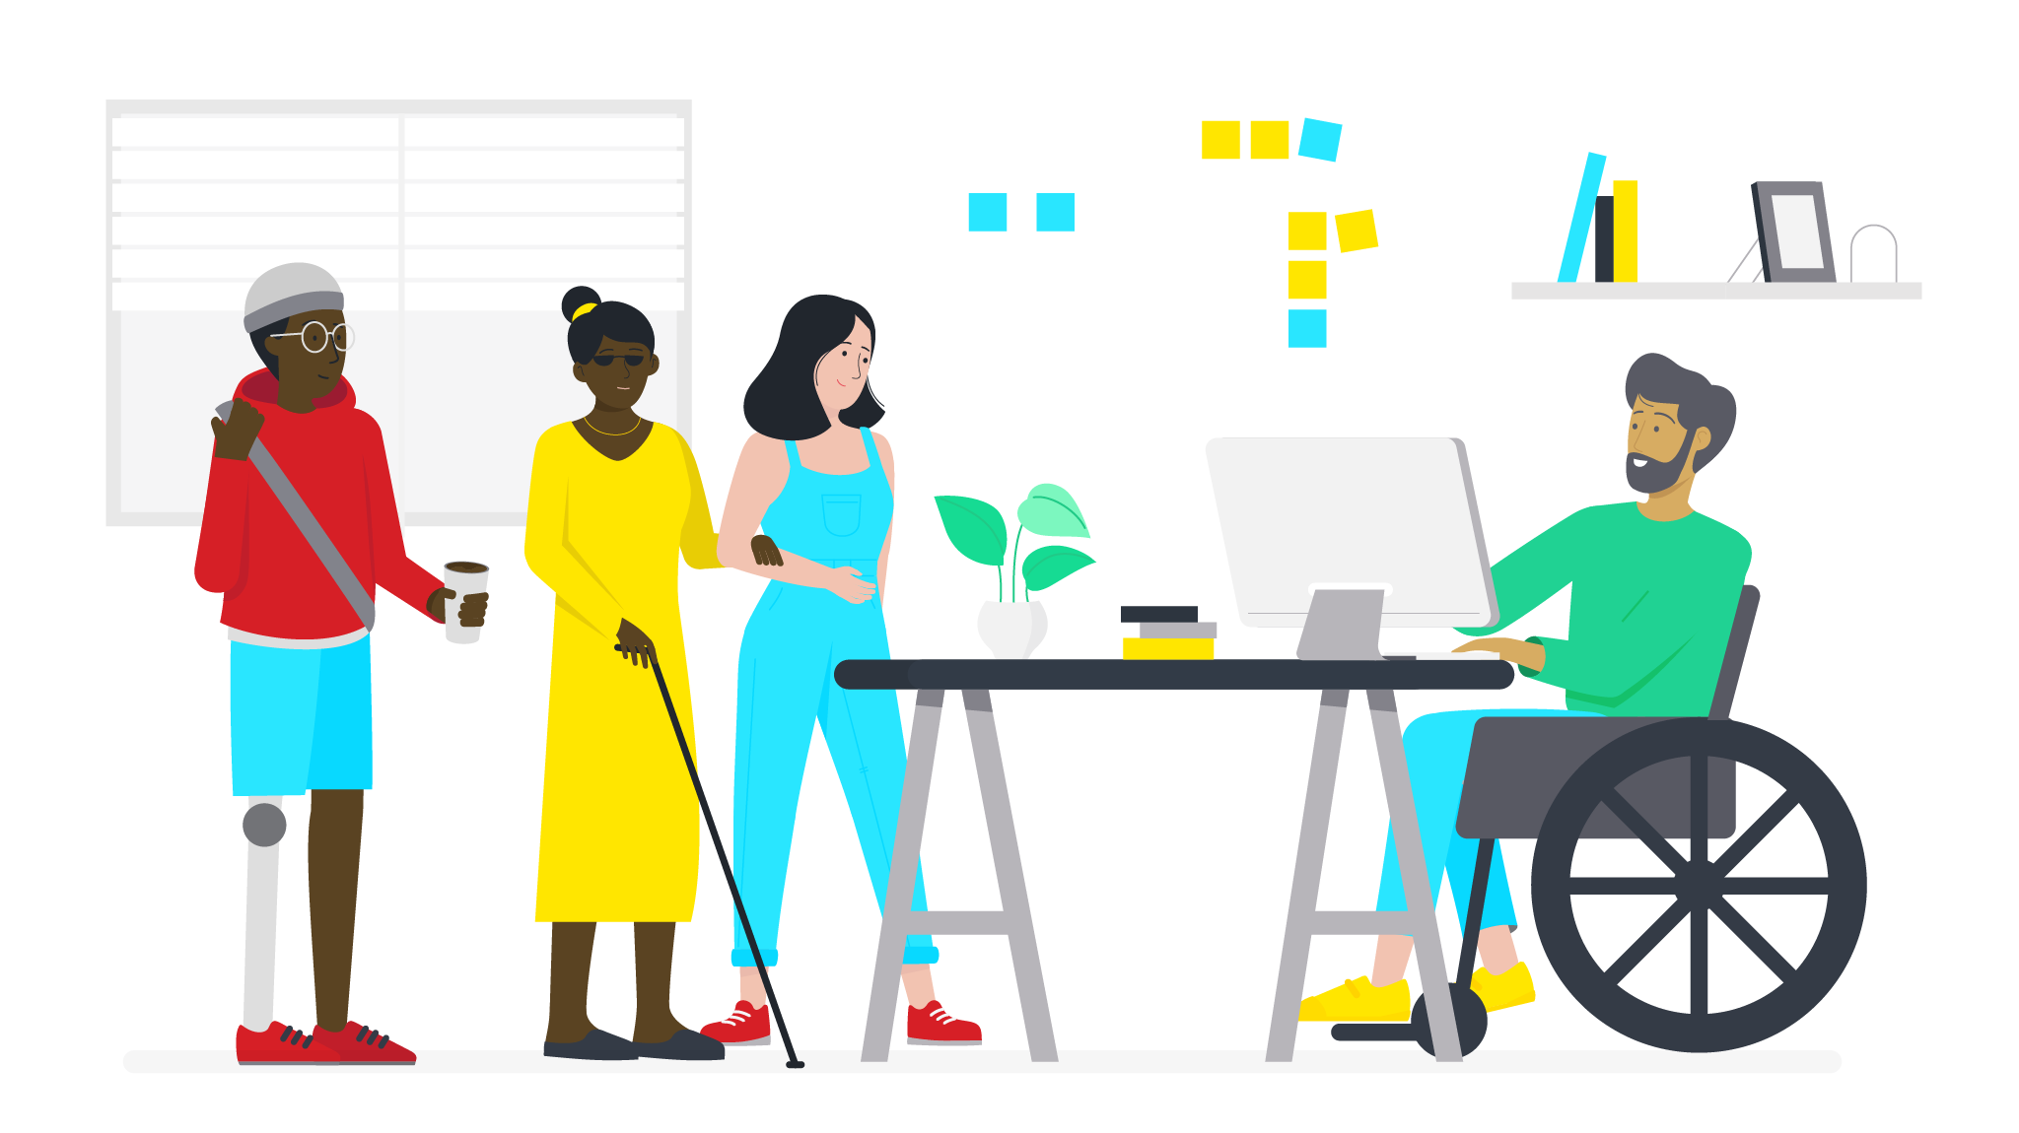
Accessibility and Inclusiveness
Extent to which an interactive product is accessible by as many as users possible, irrespective of impairments.
Can be achieved by
Inclusive design of technology
Design of assistive technology

Slide 25
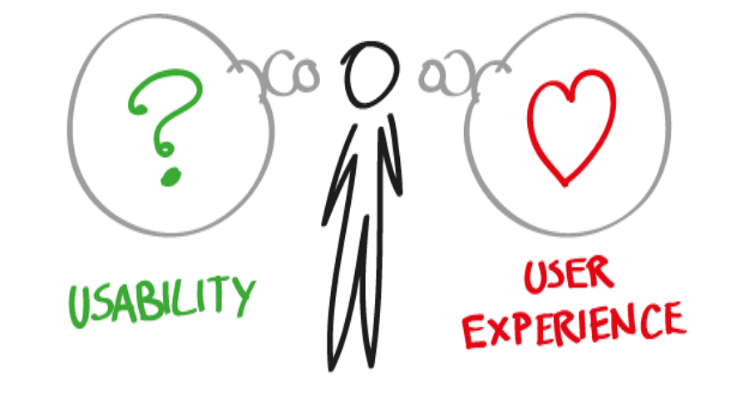
Usability and User Experience Goals
Usability goals are concerned with meeting the specific criteria, narrow and focused.
User Experience goals are explicating the nature of user experience in broader and holistic way.

Slide 26
Usability Goals
Effectiveness
Efficient
Safe
Utility
Learnability
Memorability

Slide 27
Usability Goals
Effectiveness
How good the product is at doing what it is supposed to do?
Efficient
Does product support user in carrying out task?How much resources(usually time) are used in carrying out the task
Safe
Protecting the user form dangerous conditions and undesirable situations.

Slide 28
Usability Goals
Utility
If the product provides right kind of functionality
Learnability
Is the system easy to learn
Memorability
How easy the product is to remember how to use, once learned.

Slide 29
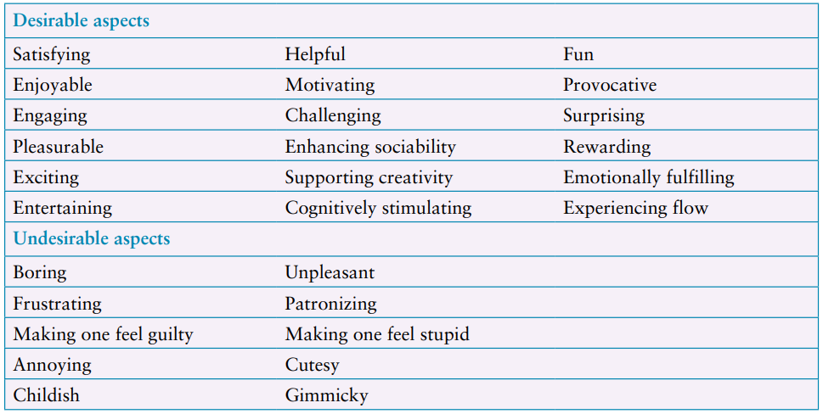
User Experience Goals
It also involves micro-interactions (small moments of interaction between user and design).

Slide 30
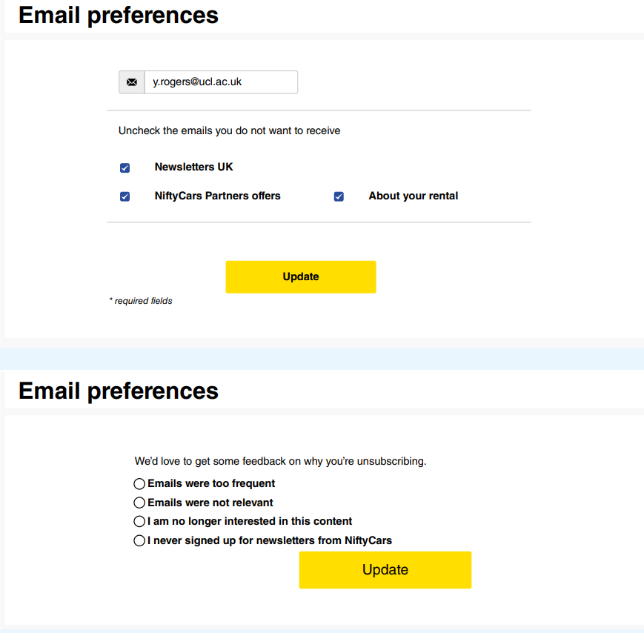
Beyond Usability: Designing to Persuade
Focus more on user- experience and less on usability
Avoid DARK PATTERNS i.e. deceptive approaches within the interface design.

Slide 31
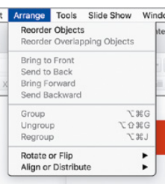
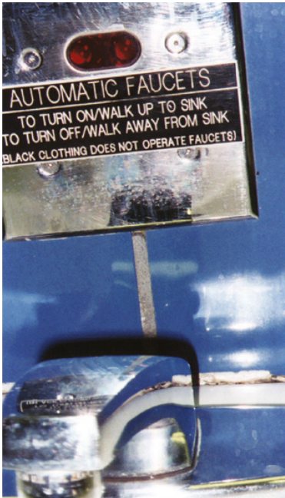
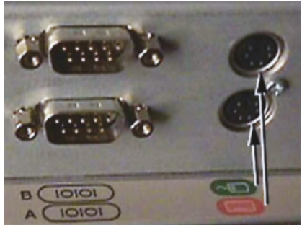
Design Principle
Visibility
Feedback
Constraints
Consistency
Affordances

Slide 32
So Why Interaction is Important?
Human
Computer
Task

Slide 33
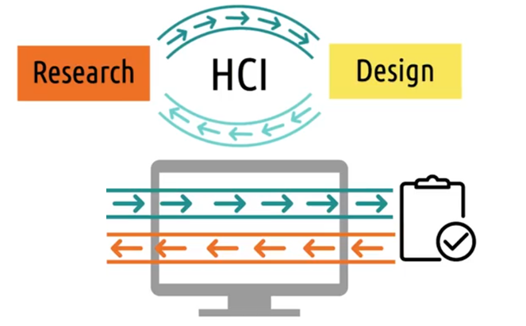
HCI: Research and Design

Slide 34
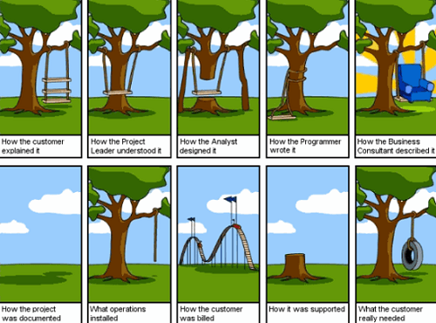
Conclusion
Human Computer Interaction
Interaction design
User Experience
Understanding Users
Accessibility and Inclusiveness
Usability and User Experience goals.

Slide 35
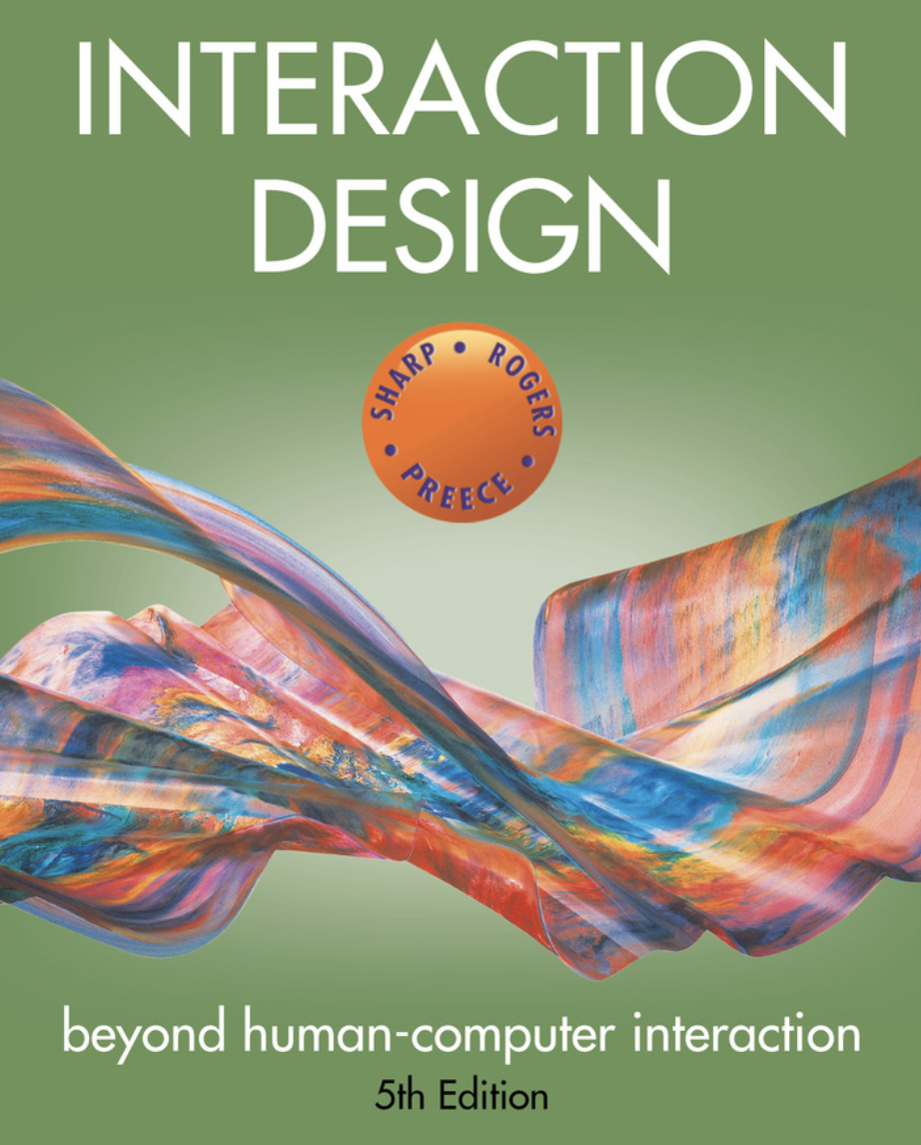
Reading Assignment
Section 1.2 : examples of voice mail and TV remote , keyboard on smart tv remotes issues
Section 1.7.1 : usability goals
Section 1.7.3 : Design principles

